Slide 1
DS ALGO PROJECT
BY RISING NINJA
Team Members
Indu Bala LNU
Priyanka Agarwal
Sheetal Karotiya
Vivien Obitulata-Ugwu

Slide 2
Project Objectives
Develop a selenium-based Automation framework for https://dsportalapp.herokuapp.com/ website
Integrated Cucumber for BDD test Scenarios
Performed Cross-Browser testing with TestNG
Use Git for Version Control
Collaborated on Github for Team Contributions
Reported Bug in Jira for failed Scenarios
Implemented Jenkins for Continuous Integration.
Generated Detailed Test Reports

Slide 3
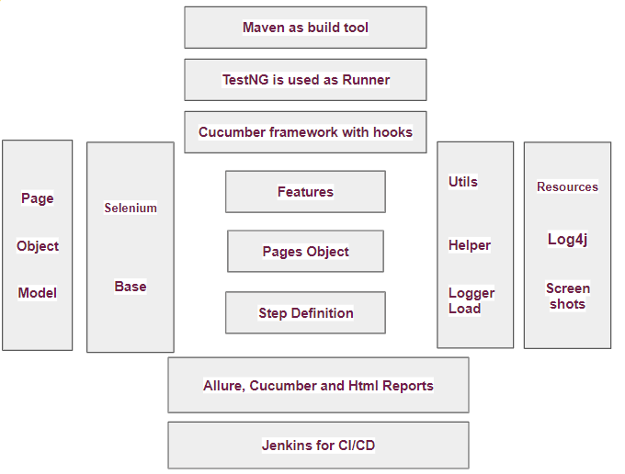
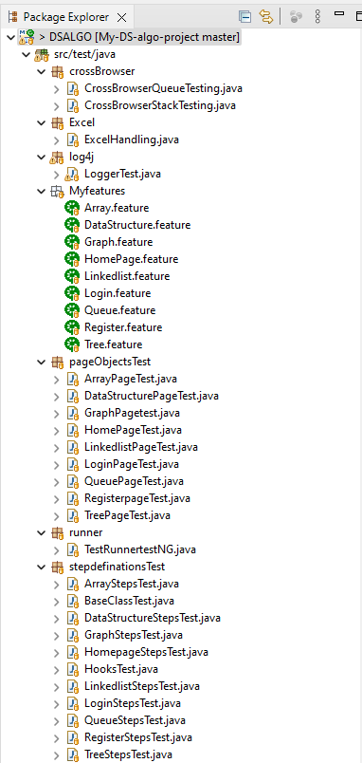
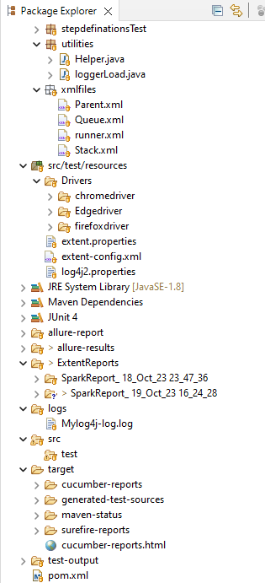
Framework Architecture And Project Folder Structure

Slide 4
Components of FrameWork Structure
Cucumber BDD FrameWork with Page Object Model
Helper(core) - which Manages Our WebDriver Configurations and Setup
Hooks - which allows to define Pre-test and post Test Actions.
Logger - To Maintains Console Logs
Base Class - Contains all the Imported PageOjects Class file and Extends in the entire framework
Feature Files Define All the Test Scenarios using Gherkin Format .
PageObjects Files Extending Base Class file to inherit common Functionality
Stepdefinition Files which links the Gherkins steps and features files
Test Runner File Which execute all features to run and generates test reports
Performed Cross Browser Testing in Chrome, Firefox and Edge.
For Stack and Queue Modules execute Parallel testing
Created The Parent xml file Inherits the Child TestNG xml files.
Integrated the Parent xml into our Pom xml to execute Test cases in Sequence

Slide 5
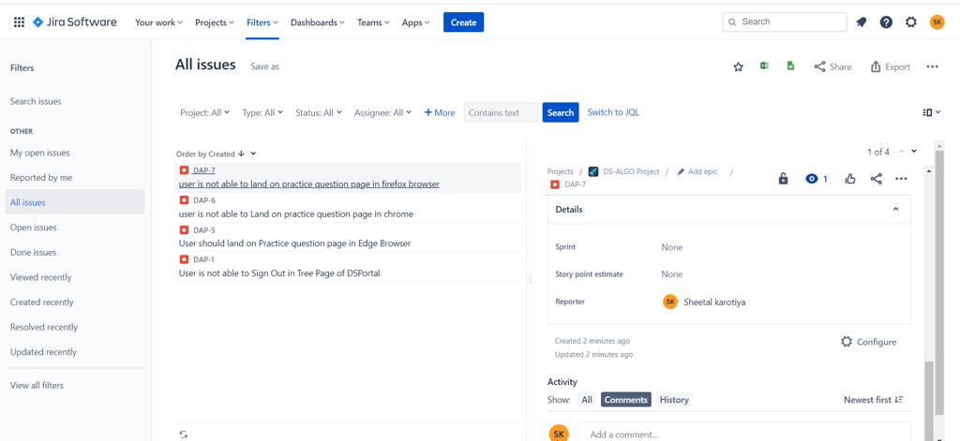
Jira Ticket

Slide 6
For Reporting
Allure Reports
Extent Reports
Provides detailed and interactive test reporting with graphs and charts
Provides detailed information about test execution,Pass/fail status, logs,screenshots
Also Generate Html ,PDF and Spark
Cucumber Reports
TestNG Reports
Designed specifically for Cucumber based BDD test frameworks
TestNG generates HTML reports by default after each test run

Slide 7
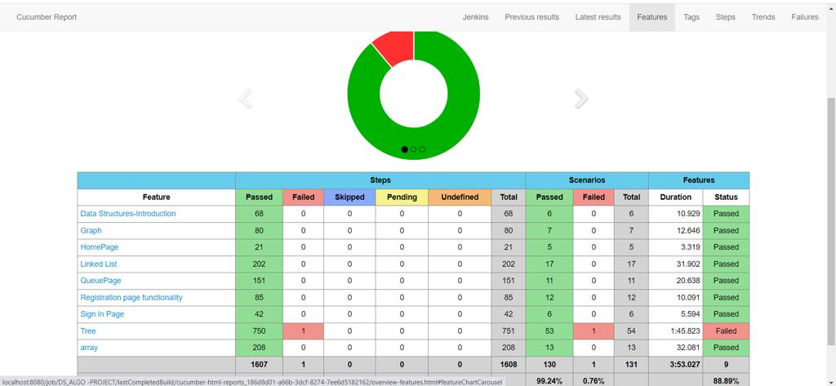
Cucumber Report

Slide 8
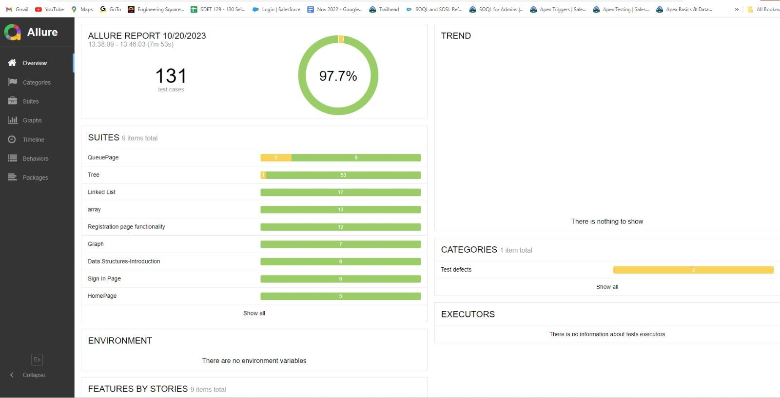
Allure Report

Slide 9
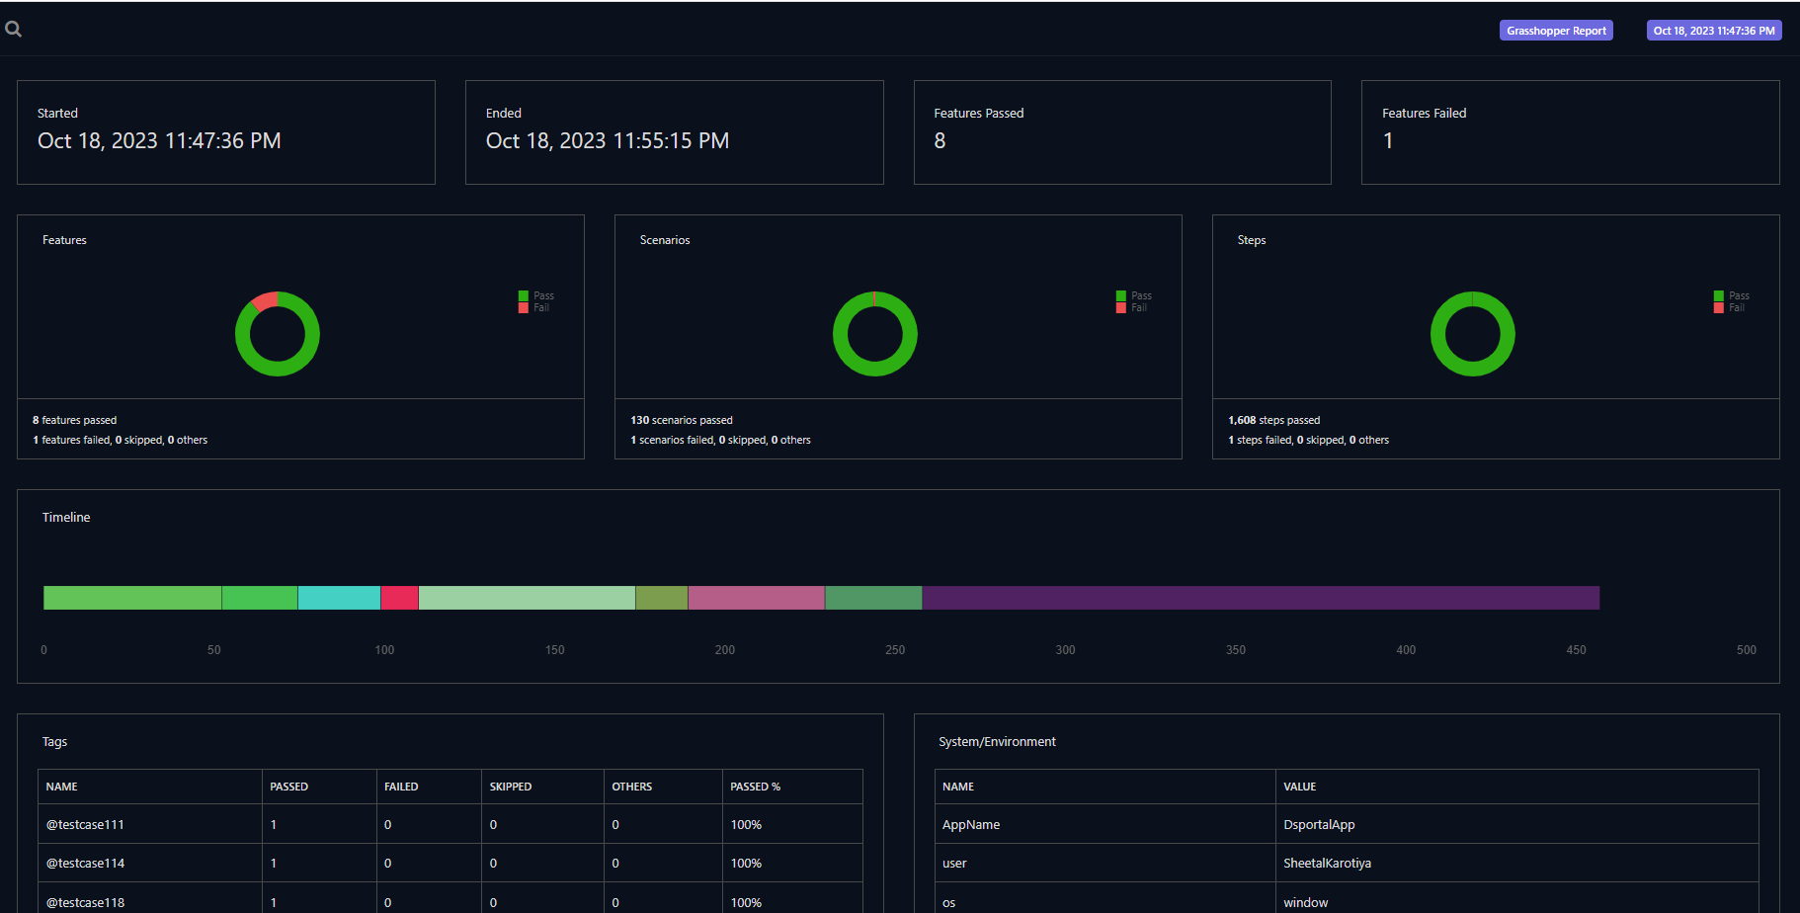
Extent Spark Report

Slide 10
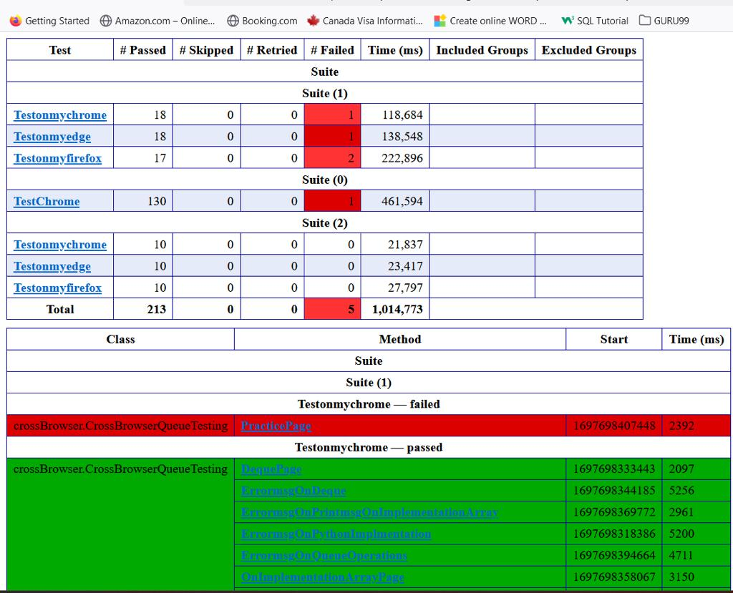
TestNG Report (emailable .html)

Slide 11
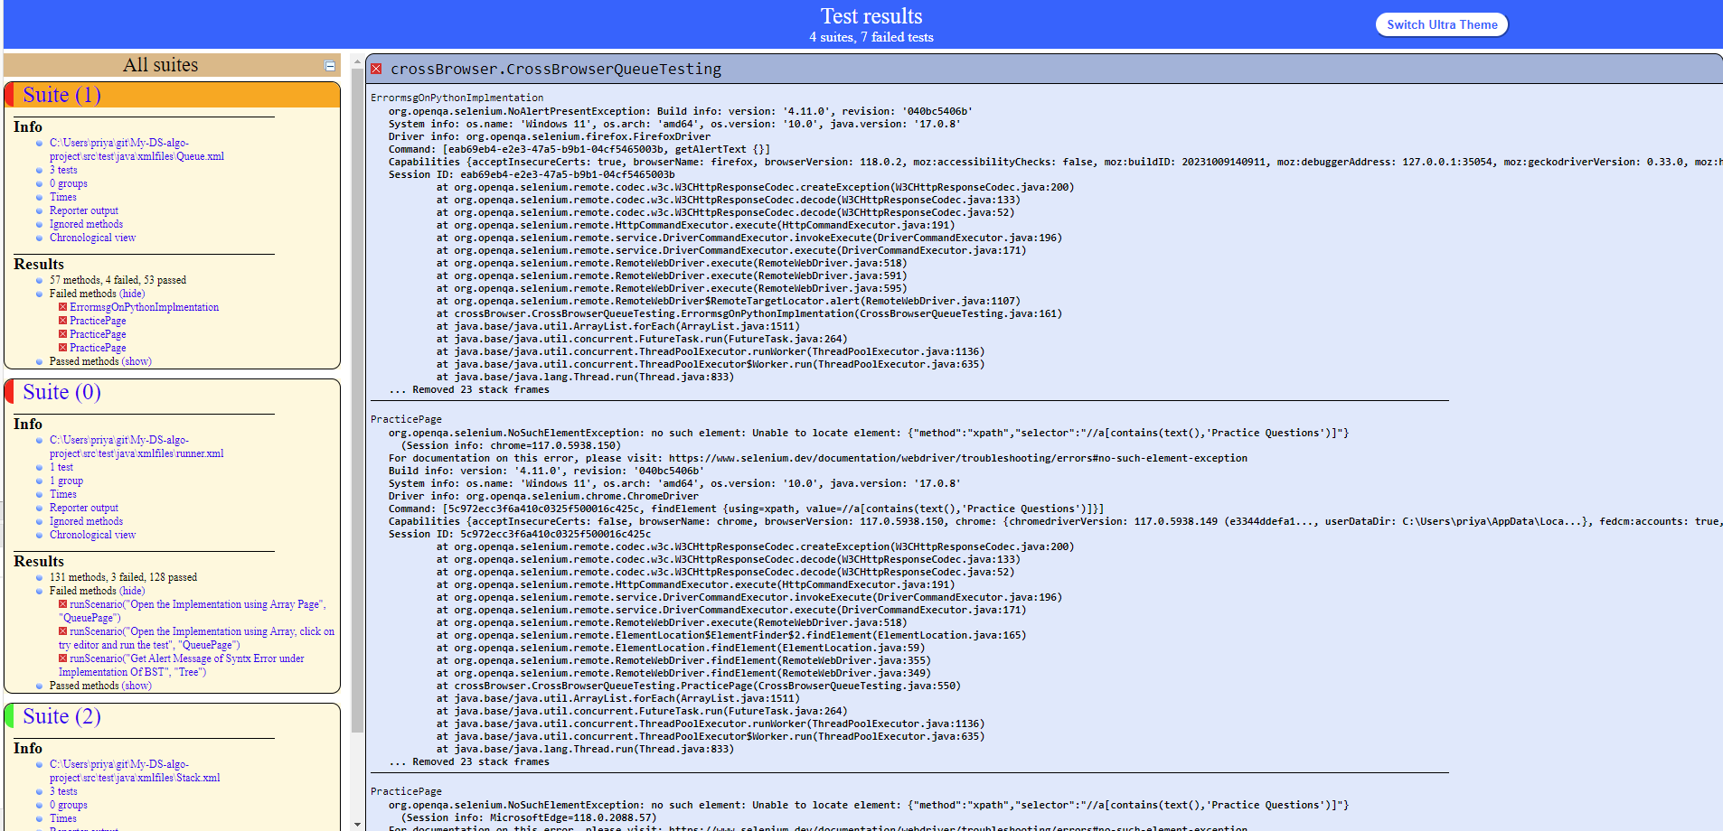
TestNG Report (index.html)

Slide 12
Challenges Faced
Found Solution
Step Duplications issue.
Github push and pull.
Re-created the Whole Project
Jenkins Installation
Difficulty Running the Pom.xml file
Referred Numpy Ninja Blog.
Referred Some you-tube-Video.
By Adding Base Class, Hooks & Page Object Class file
Referred Numpy Ninja Blog.
By Adding Parent TestNG xml into Pom .xml

Slide 13
Team Learnings
Designing FrameWork with Page Object Model
How to Push and Pull Code in Github
How to Integrate with Jenkins
How to Raise bug in Jira
&quot;Implementing parallel execution in cross-browser testing
Creation of various report types such as Allure, Cucumber, Extent, and TestNG reports,
Conversed during daily stand-up briefings on calls & WEBEX Meetings
Mutually assisting one another in tackling challenges while accomplishing the assigned tasks.

Slide 14
Thank You

